Slide 1
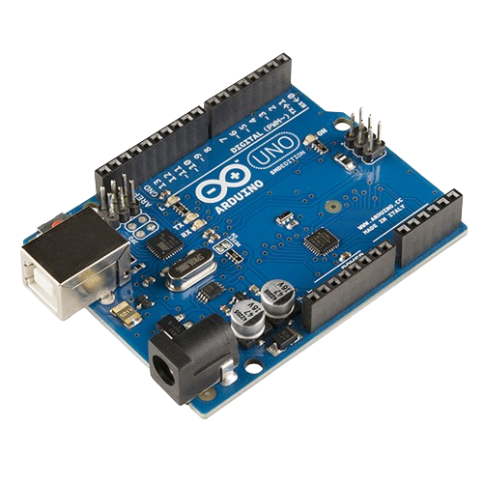

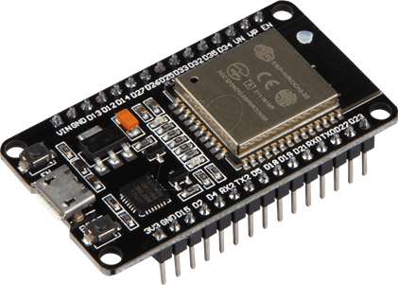
Circuit Circus: Arduino and ESP32
Power Up Your Projects!
By T Tushar Shenoy and Sourabh Shenoy

Slide 2
Circuit Guide
Electronic Components
Concepts and Terminologies
What is a Microcontroller?
Getting Started with Tinkercad & Arduino IDE
Exploring Arduino UNO
Exploring ESP32

Slide 3
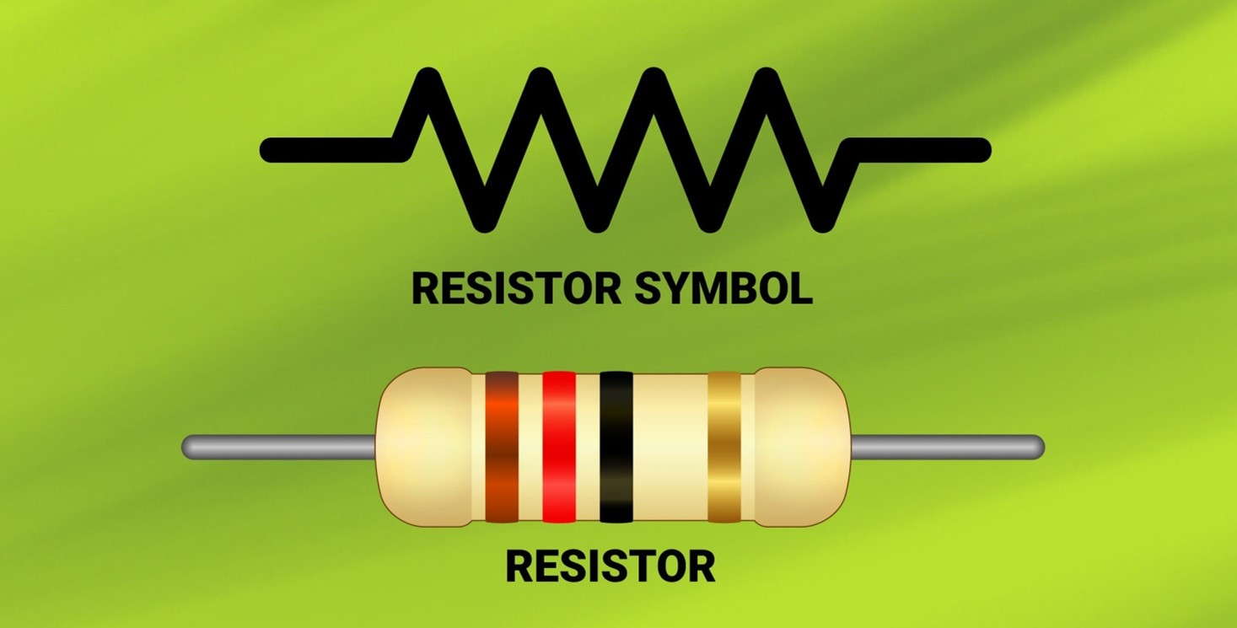
Electronic Components
May R bless us with the power to resist short circuits, L give us the strength to induct good vibes into our circuits, and C help us store the energy to keep going strong. With their blessings, let's embark on this electrifying journey into the world of electronics!
Resistors : A passive electrical component with two terminals that are used for limiting the flow of electric current in electrical circuits.
The SI unit of resistor is Ohm.
Denoted by R

Slide 4
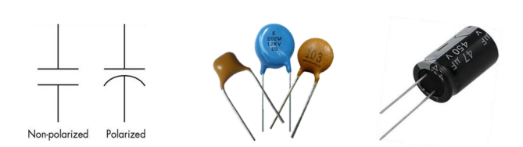
Electronic Components
2) Capacitor : A capacitor is a two-terminal electrical device that can store energy in the form of an electric charge.
The SI unit of Capacitor is Farad
Denoted by C
Symbol Capacitor

Slide 5
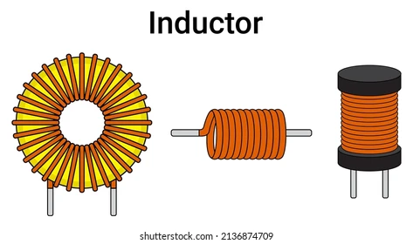
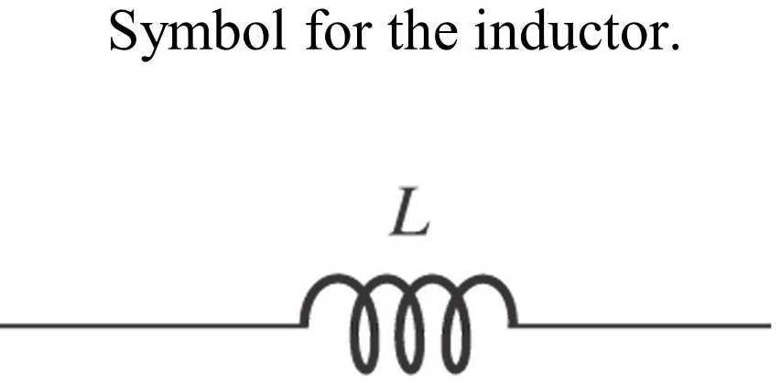
Electronic Components
3) Inductor : A Inductor is a passive component that is used to store energy temporarily in an electromagnetic field.
The SI unit of Inductor is Henry
Denoted by L

Slide 6
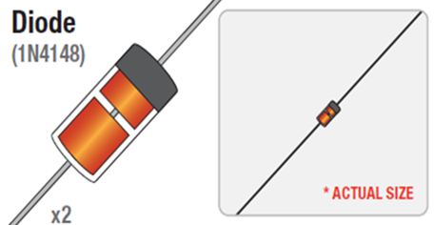
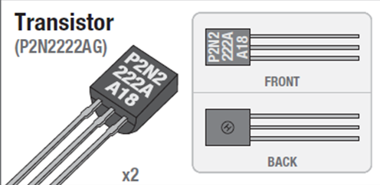
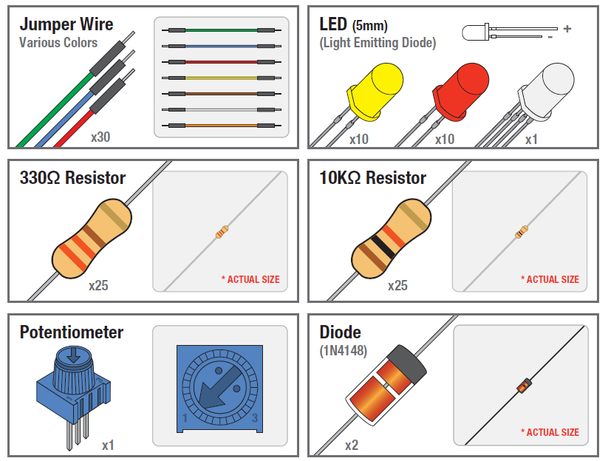
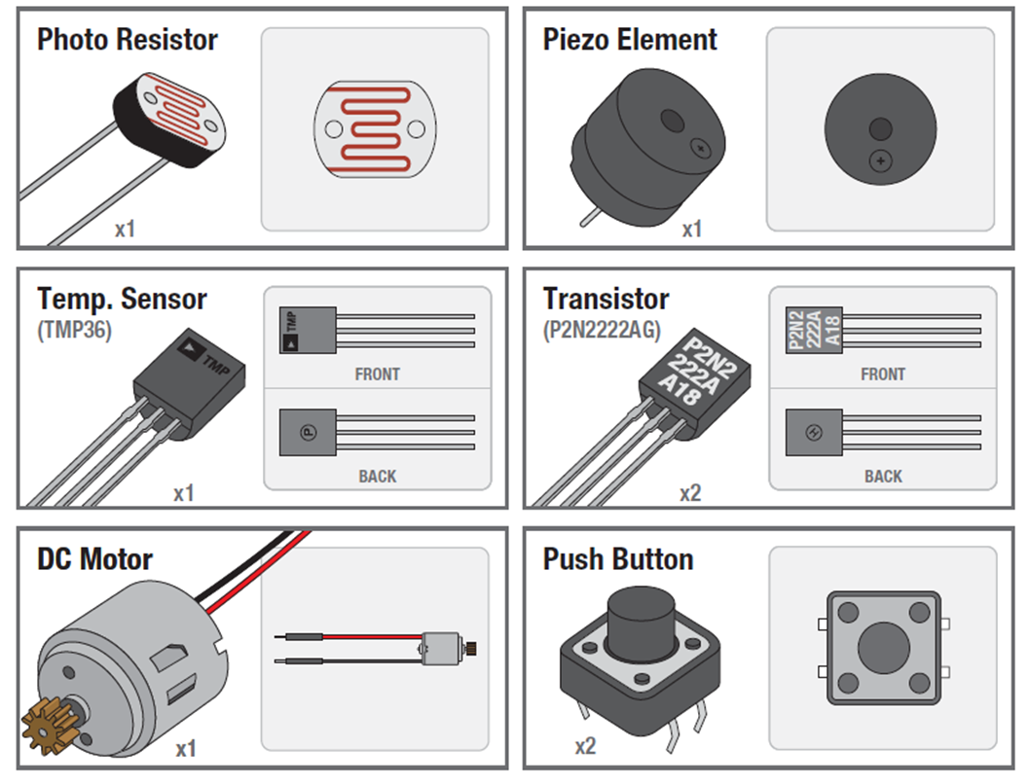
Electronic Components

Slide 7
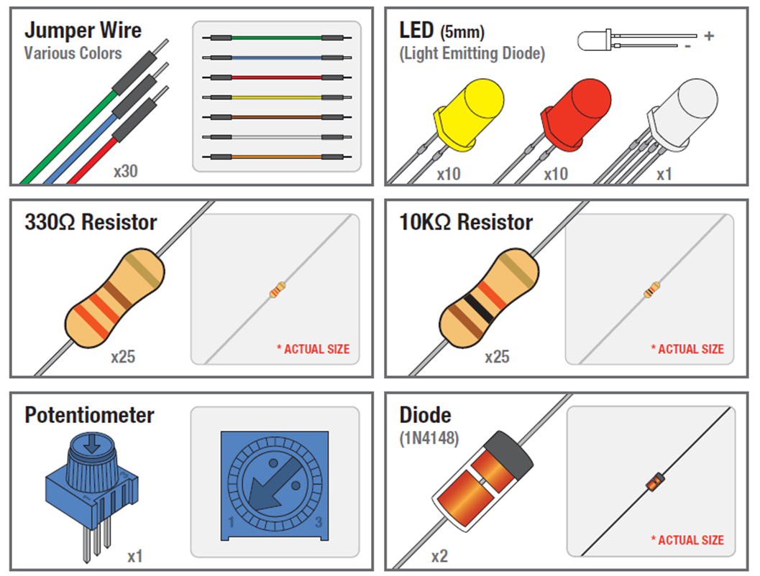
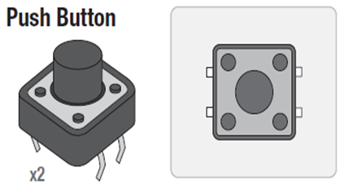
Electronic Components

Slide 8
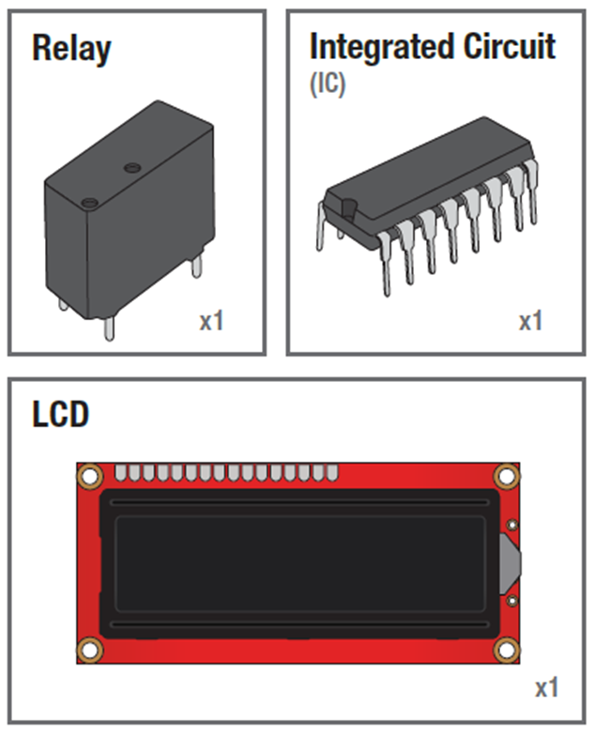
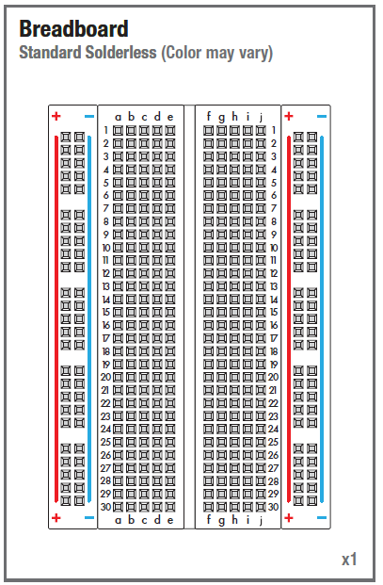
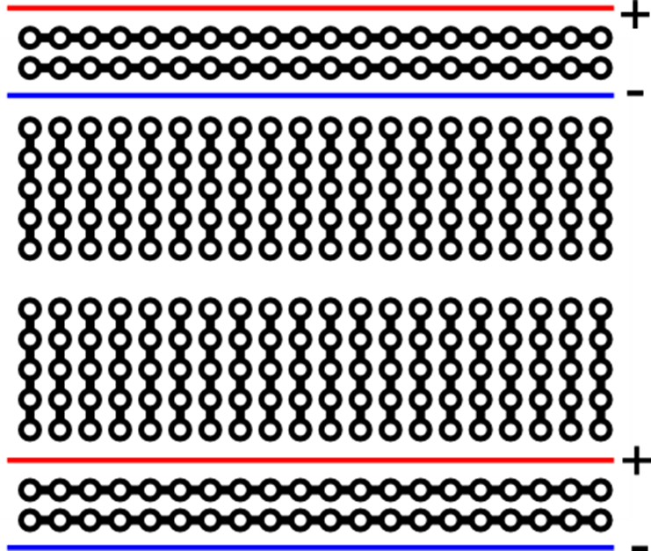
Electronic Components

Slide 9
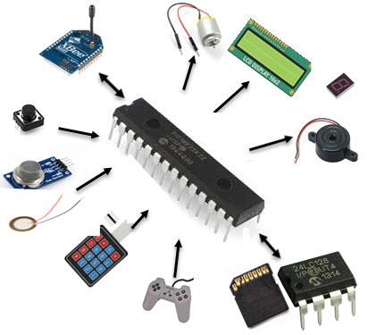
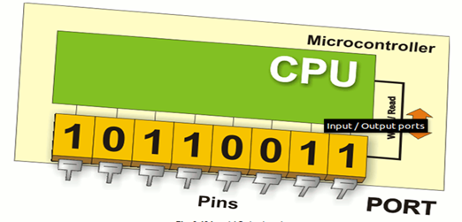
Concepts & Terminologies
INPUT and OUTPUT Devices
Input Devices: These are hardware components that provide data to the microcontroller for processing.
Examples include sensors (like temperature sensors, light sensors), buttons, and switches.
Output Devices: These are hardware components that receive data from the microcontroller after it has been processed.
Examples include LEDs, motors, and displays.

Slide 10
Concepts & Terminologies
ANALOG and DIGITAL
Analog: Analog signals are continuous and can take any value within a range. In microcontrollers, these signals are converted to digital form using an Analog-to-Digital Converter (ADC).
Example: A temperature sensor that outputs varying voltage is an analog input.
Digital: Digital signals are discrete, typically 0 or 1. Microcontrollers use digital pins to read or output these binary states.
Example: A push button that is either pressed (1) or not pressed (0) provides a digital signal.

Slide 11
Concepts & Terminologies
A communication protocol is a set of rules and conventions that enable devices to communicate with each other.
Examples :
UART
SPI
I2C
Baud Rate
Baud Rate: Speed of data transmission in bits per second (bps) over serial communication. Common rates: 9600, 115200 bps.
Serial Monitor in IDE
Serial Monitor: A tool in IDEs like Arduino for viewing and sending data over a serial connection.
Used for debugging and interacting with microcontrollers.
Set Baud Rate: Must match the microcontroller's baud rate to display data correctly.

Slide 12
What is a Microcontroller ?
Let’s Define it
Definition: MCU is a compact computer on a single chip
Purpose: Designed to control specific tasks in electronic systems
Integration: Combines CPU, memory and I/O interfaces on one chip
Role in Embedded Systems
Central Processing and Control
Integration of Essential Components
Real-time Responsiveness and Efficiency
Arduino NANO

Slide 13

Exploring Arduino UNO
Arduino UNO is a popular microcontroller board based on the ATmega328P microcontroller. It is widely used in electronics projects for both beginners and professionals due to its simplicity and ease of use.
Operating Voltage: 5V
Digital I/O Pins: 14 (6 PWM)
Analog Input Pins: 6
Flash Memory: 32 KB
Clock Speed: 16 MHz
USB Connection: For programming and power
Power Supply: 7-12V via power jack or USB

Slide 14
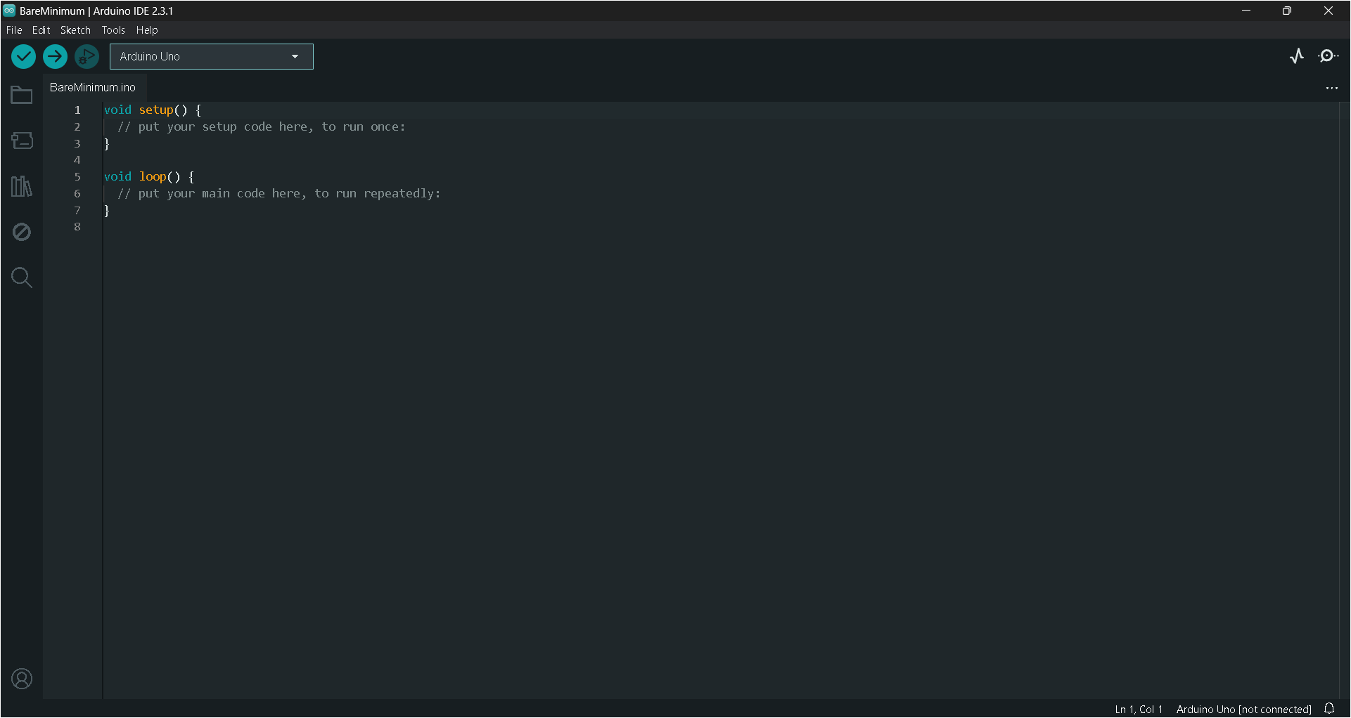
How to Program it?
Arduino IDE is an open-source software platform used for writing, compiling, and uploading code to Arduino boards.
It provides a user-friendly interface with built-in libraries and examples, making it easy to develop and debug projects on various Arduino-compatible microcontrollers.

Slide 15
Programming Guide
Basic Structure :
void setup() {
// Initialization code here (runs once)
}
void loop() {
// Main code here (runs repeatedly)
}
Pin Modes :
pinMode(pin, INPUT); // Set pin as input
pinMode(pin, OUTPUT); // Set pin as output

Slide 16
Programming Guide
Digital I/O:
digitalWrite(pin, HIGH); // Set pin to HIGH
digitalWrite(pin, LOW); // Set pin to LOW
int val = digitalRead(pin);// Read digital value (HIGH or LOW)
Analog I/O:
int val = analogRead(pin); // Read analog value (0-1023)
analogWrite(pin, value); // Write PWM value (0-255)

Slide 17
Programming Guide
Serial Communication:
Serial.begin(9600); // Start serial communication at 9600 baud
Serial.print("Hello"); // Print text to serial monitor
Serial.println("World!"); // Print text with newline
int val = Serial.read(); // Read incoming serial data
Delay:
delay(ms); // Pause for specified milliseconds

Slide 18
Programming Guide
Control Structures :
if (condition) {
// Code if condition is true
} else {
// Code if condition is false
}
for (int i = 0; i < 10; i++) {
// Loop 10 times
}
while (condition) {
// Loop while condition is true
}

Slide 19
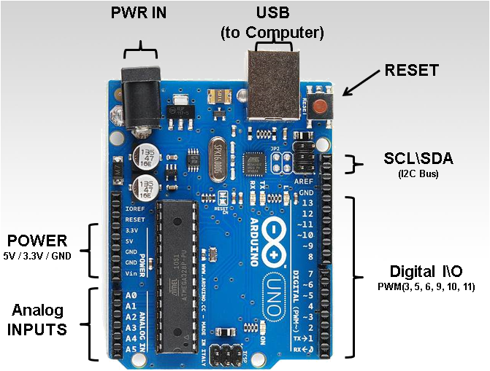
Arduino UNO Pinout

Slide 20
Let’s Program
Hello World of Electronics “LED Blinking”
- Tinkercad-Simulation-01_LED_Blinking
2) Analog Read to Read the Voltage
- Tinkercad-Simulation-02_Analog_Read
3) Digital Read and Write
- Tinkercad-Simulation-03_Digital_Read_Write
Distance Measurement
- Tinkercad-Simulation-04_Distance_Measurement

Slide 21
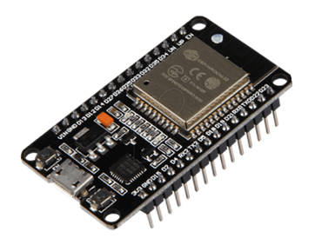
Exploring ESP32
The ESP32 is a powerful and versatile Wi-Fi and Bluetooth microcontroller, designed by Espressif Systems. It is widely used in IoT applications due to its high processing power, connectivity options and low energy consumption.
Microcontroller: Dual-core Xtensa.
Operating Voltage: 3.3V.
SRAM: 520 KB.
GPIO Pins: 34 (multiple functions like PWM, ADC, DAC, touch, etc.).
Analog Inputs: 18 channels of ADC (12-bit).
Digital-to-Analog Converter (DAC): 2 channels (8-bit).
Communication Interfaces: UART, SPI, I2C.
Clock Speed: Up to 240 MHz.

Slide 22
Let’s Program
Point to be Noted :
The ESP32 utilizes the Arduino framework, so the same code used for the Arduino UNO can be adapted for the ESP32 by modifying the pin numbers. This allows you to use similar code for LED blinking and integrating other components with the ESP32.
1) Webserver Controlled LED
2) AP Controlled LED
3) Bluetooth Controlled LED
Simulator for ESP32 : Wokwi Simulator

Slide 23
Problem Statements
Smart Temperature and Humidity Monitor
Bluetooth Controlled Smart Light
Interactive Distance Measurement Tool
Automated Plant Watering System
RFID-Based Attendance System
Obstacle-Avoiding Robot
Smart Doorbell with Visitor Notification
Home Security System with Motion Detection
Weather Station with Data Logging
Smart Waste Bin with IoT Connectivity

Slide 24
Additional Resources
Arduino Framework : https://www.arduino.cc/reference/en/ (Programming Guide)
Arduino & Espressif websites: https://www.arduino.cc/
https://www.espressif.com/en
Electronics Project Websites : https://randomnerdtutorials.com/
https://lastminuteengineers.com/
https://howtomechatronics.com/
https://www.instructables.com/
Websites to Buy Components : https://robu.in/
https://robocraze.com/
GitHub Repository : https://github.com/tusharshenoy/Circuit-Circus-Arduino-ESP32-Edition

Slide 25


